Slide 1
Lakers Offseason Opportunities
By:Taylor Cobbs
Data collected from:
https://www.basketball-reference.com/contracts/players.html
https://www.nba.com

Slide 2
Business Task
To find trends in data about top 4 teams in each division
Analyze Lakers regular season data against these teams
Find players that need to be released or traded
Find players that are free agents that have appropriate contract value

Slide 3
Data Source
Data used came from https://www.basketball-reference.com/contracts/players.html. This is an open source website that contains data on current NBA players and their contracts as well as other statistics.
Data used came from https://www.nba.com/. This website contains official data on all NBA players including advanced statistics. This also contains information on future free agents and contract extensions giving me insight on potential acquisitions for the Lakers in the 2024 offseason.

Slide 4
Data Cleaning
Data Cleaning Log
5/21/2024 9:15pm - Removed players no longer on payroll from either contract release or trade to another team. Removed 41 rows.
5/21/2024 9:53pm - Removed one row of salary not meeting correct number of digits.
5/23/2024 9:34pm - Made new sheet by transfering top 8 players ranked in minutes to another sheet.

Slide 5
Summary
Data showed that the top teams had a tightly knitted Net RTG between all 8 players
Contract value did show value in Net RTG for the lower ranked teams. This means that a cohesive team is more valuable than one or two high rated players.
The lakers had an average variance from -1 to 4 in the Net RTG category
Players that need to be removed are Cam Redish (-2.8 Net RTG) and Taurean Prince (-2.6 Net RTG).
Desired players for acquisition would need a Net RTG between 1-2 and a contract smaller than $5M per year.

Slide 6
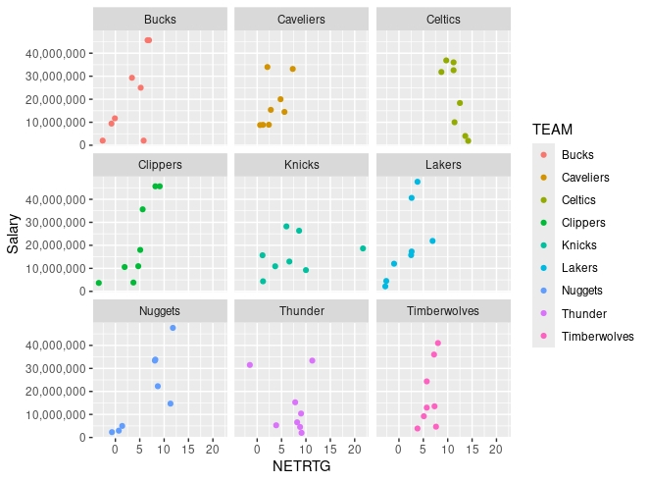

Slide 7
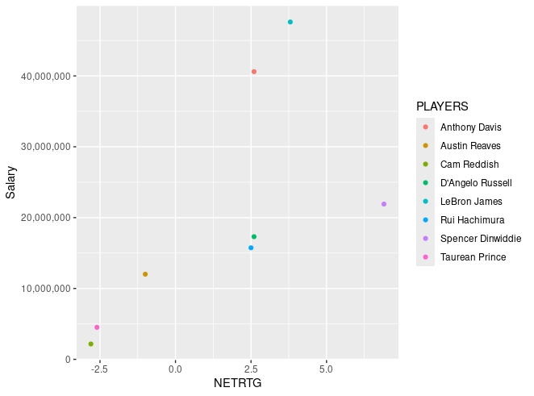
Lakers 2023-2024

Slide 8
Possible Acquisitions
Thomas Bryant - $2.8M (2.1 Net RTG)
Bol Bol - $2M (.1 Net RTG)

Slide 9
Insights
The Lakers need to remove the 2 players well below the statistical variance that are harming the team
The two star system is not as good as a well rounded good defensive team
The top seeded teams within this data set all have a small variance with contract value not creating a higher Net RTG

